Slide 1


Slide 2


Slide 3
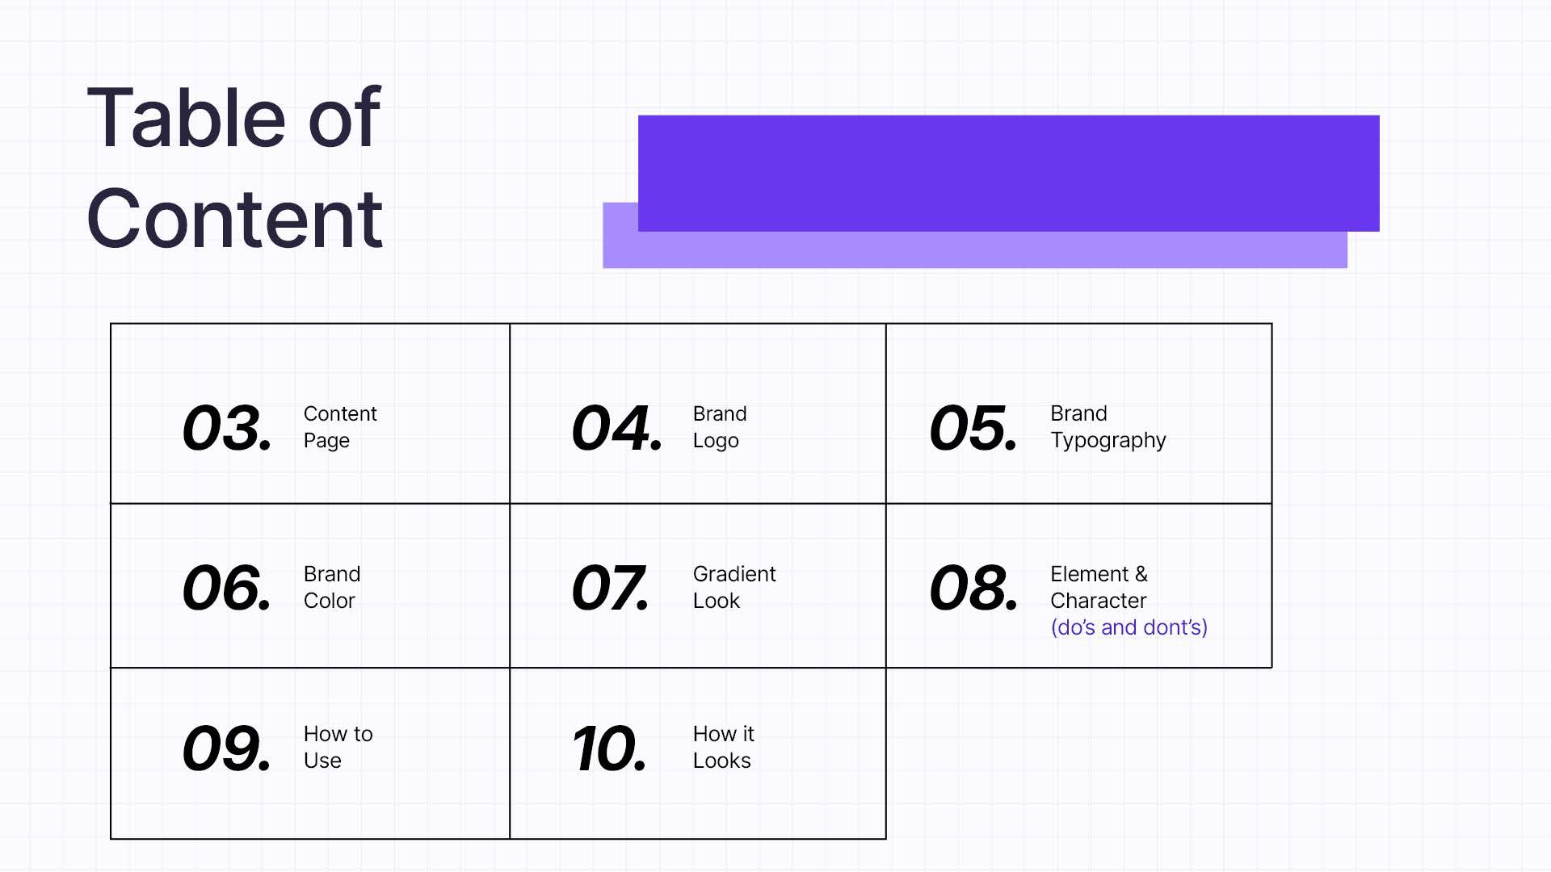

Slide 4
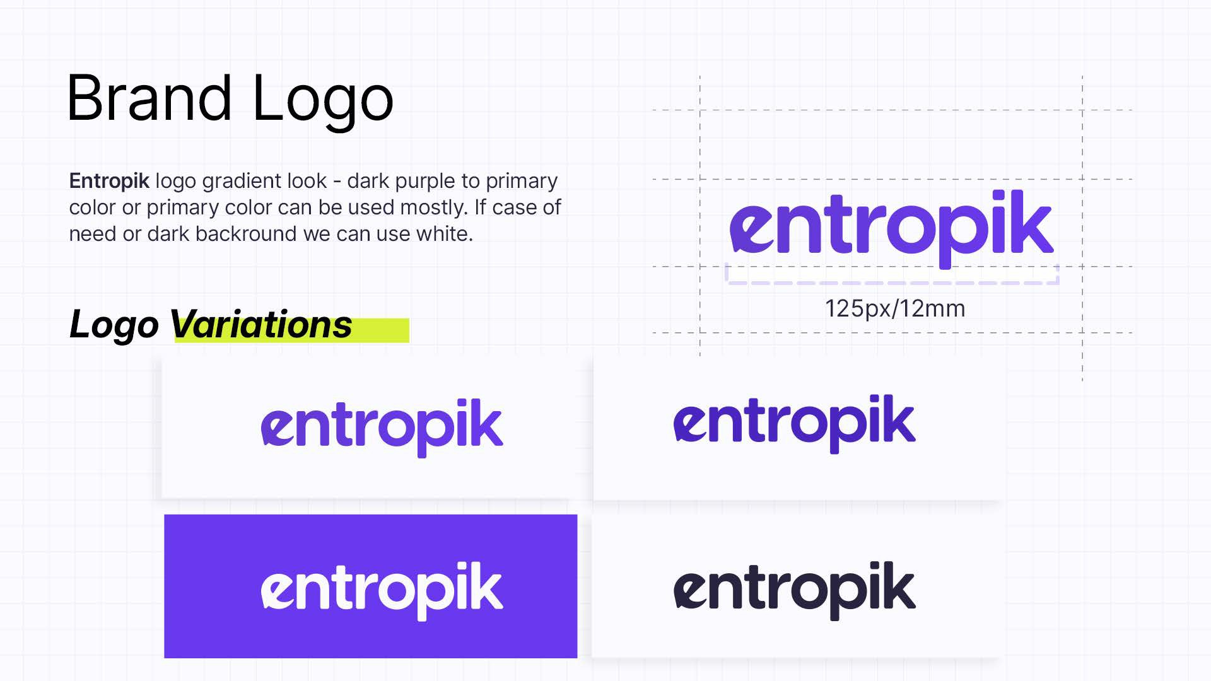

Slide 5


Slide 6


Slide 7
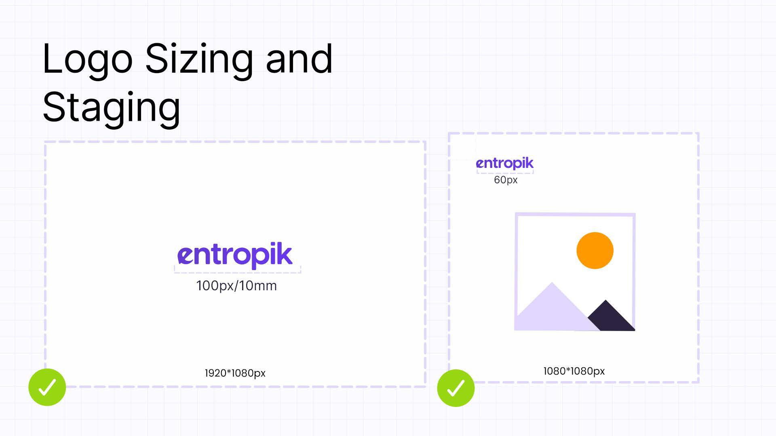

Slide 8
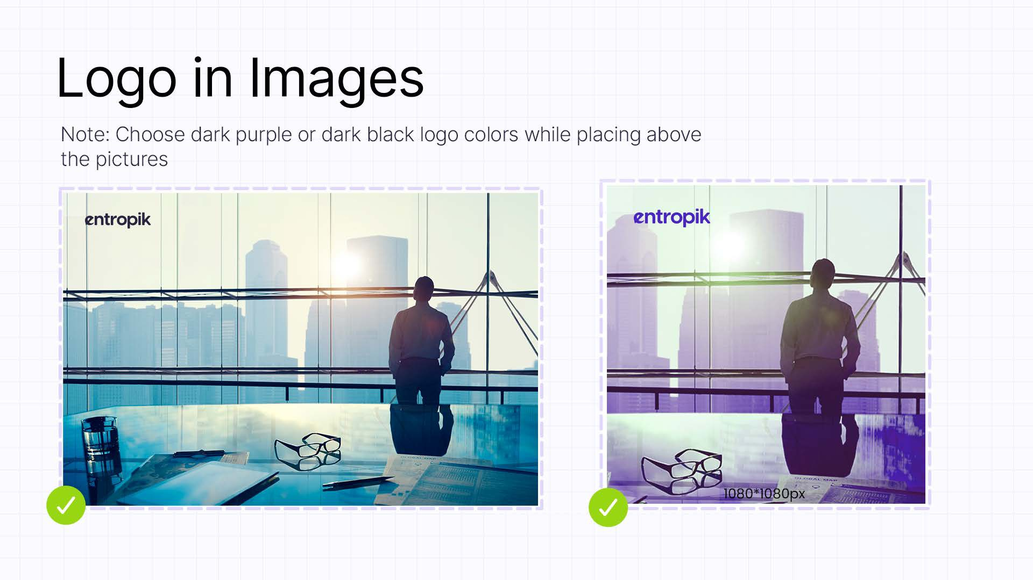

Slide 9
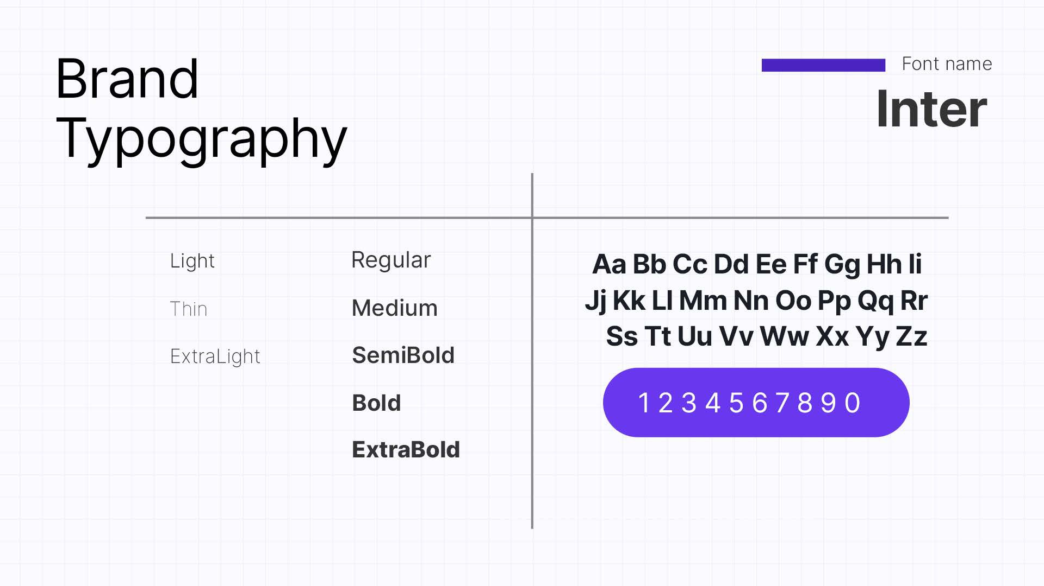

Slide 10
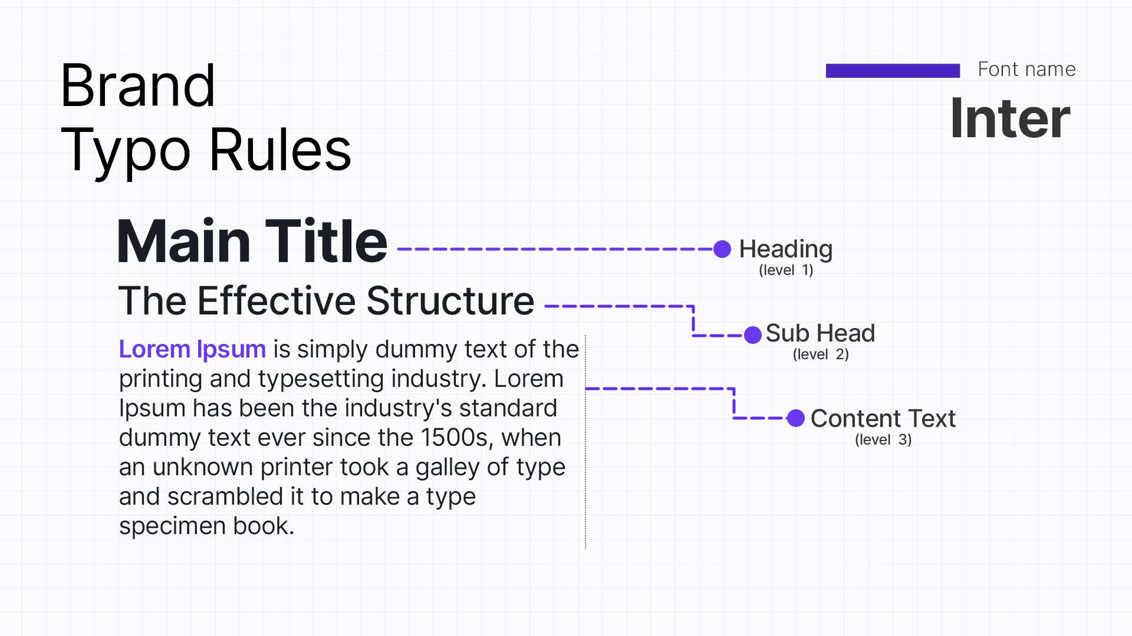

Slide 11
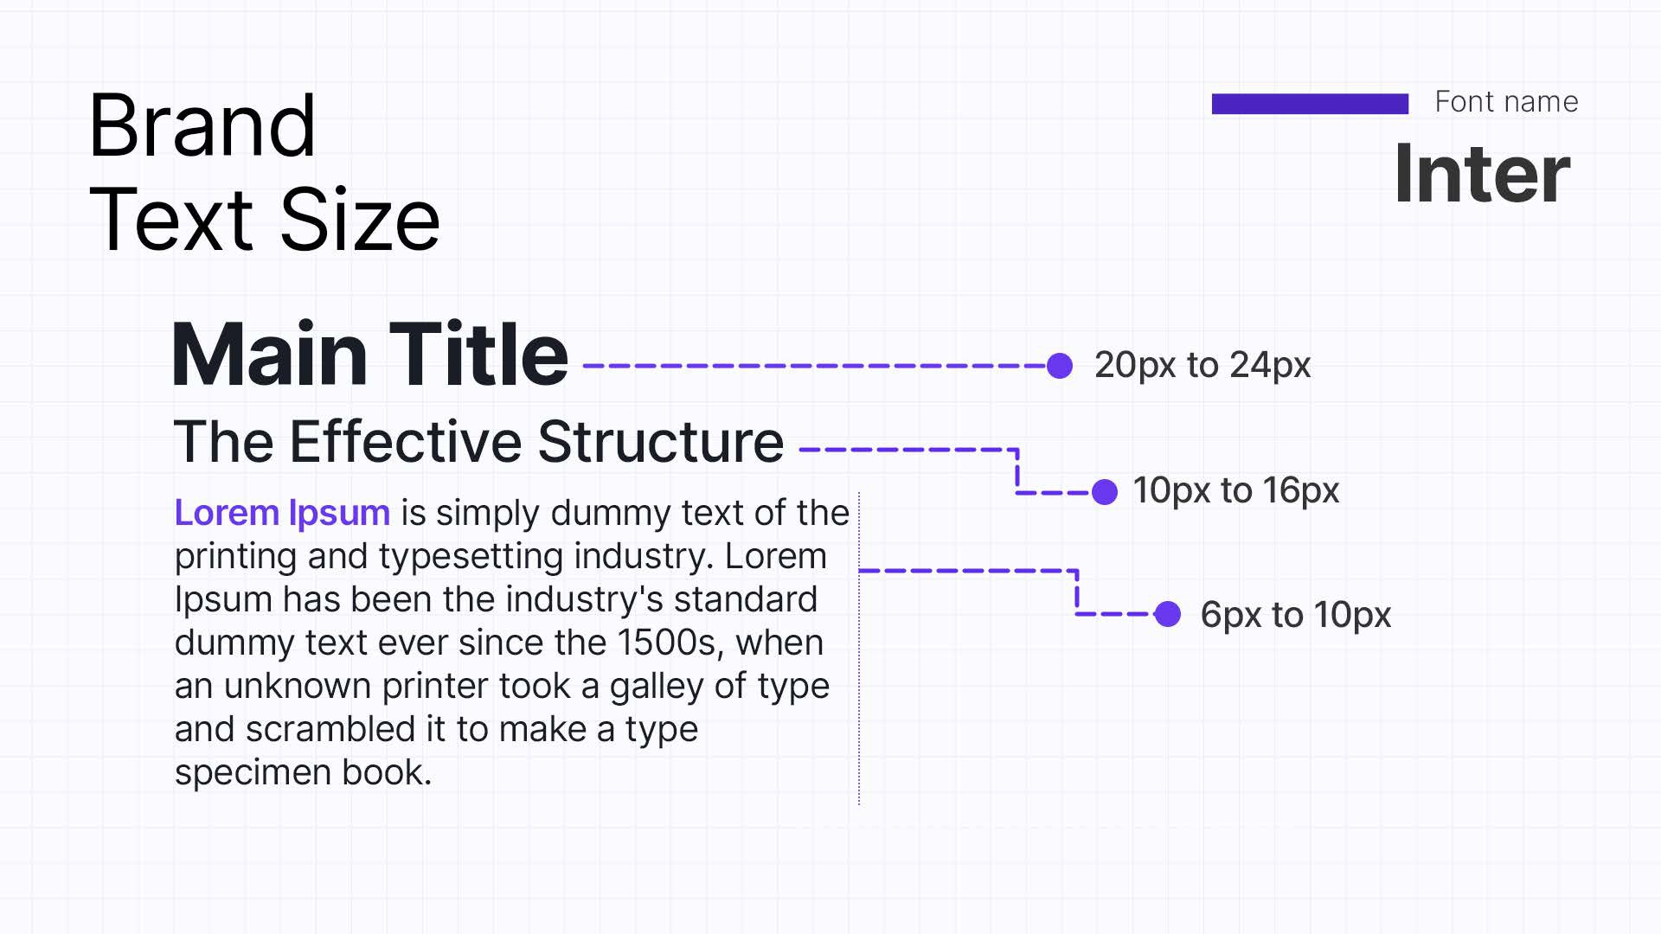

Slide 12
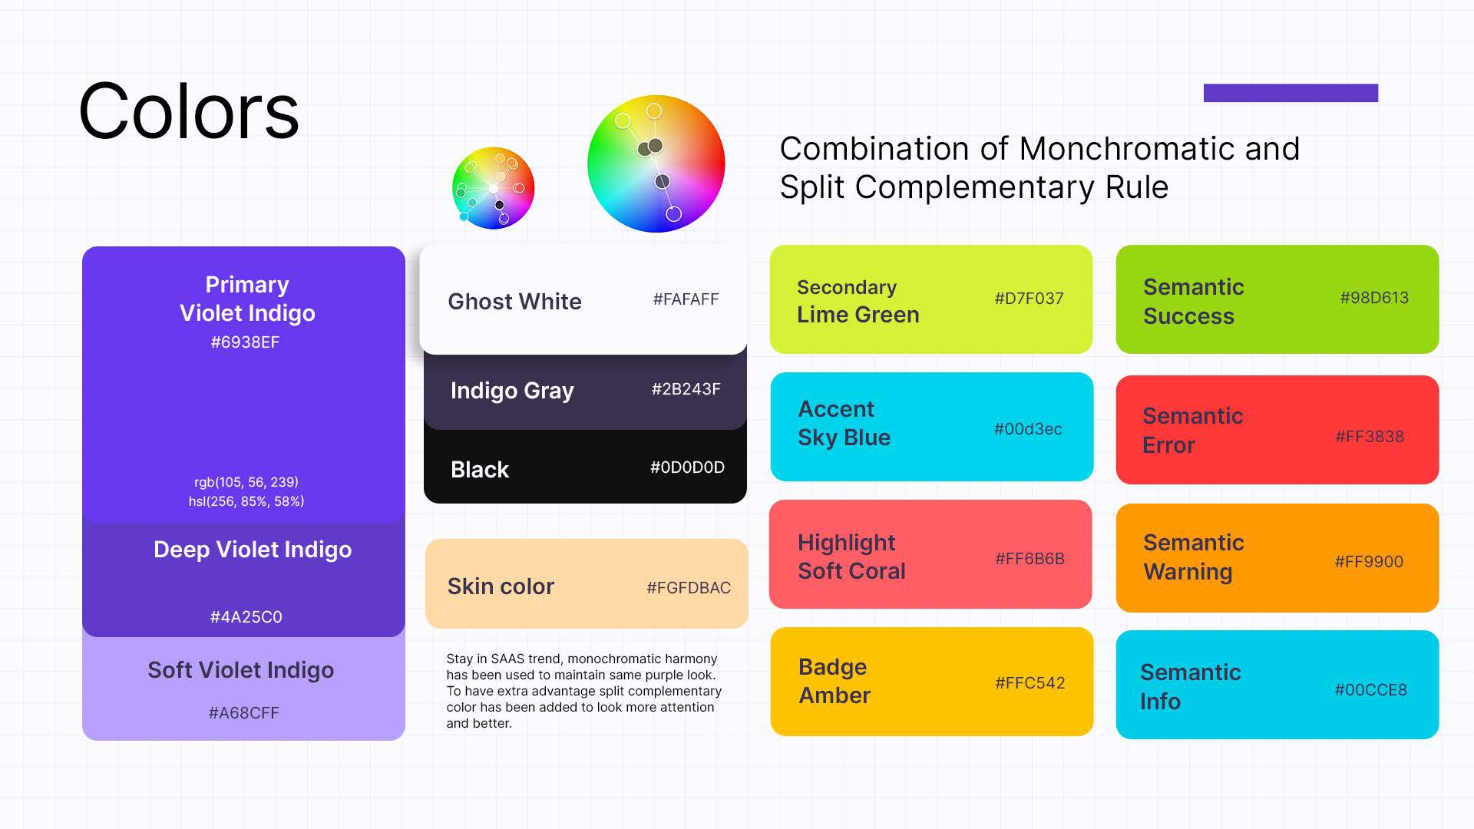

Slide 13
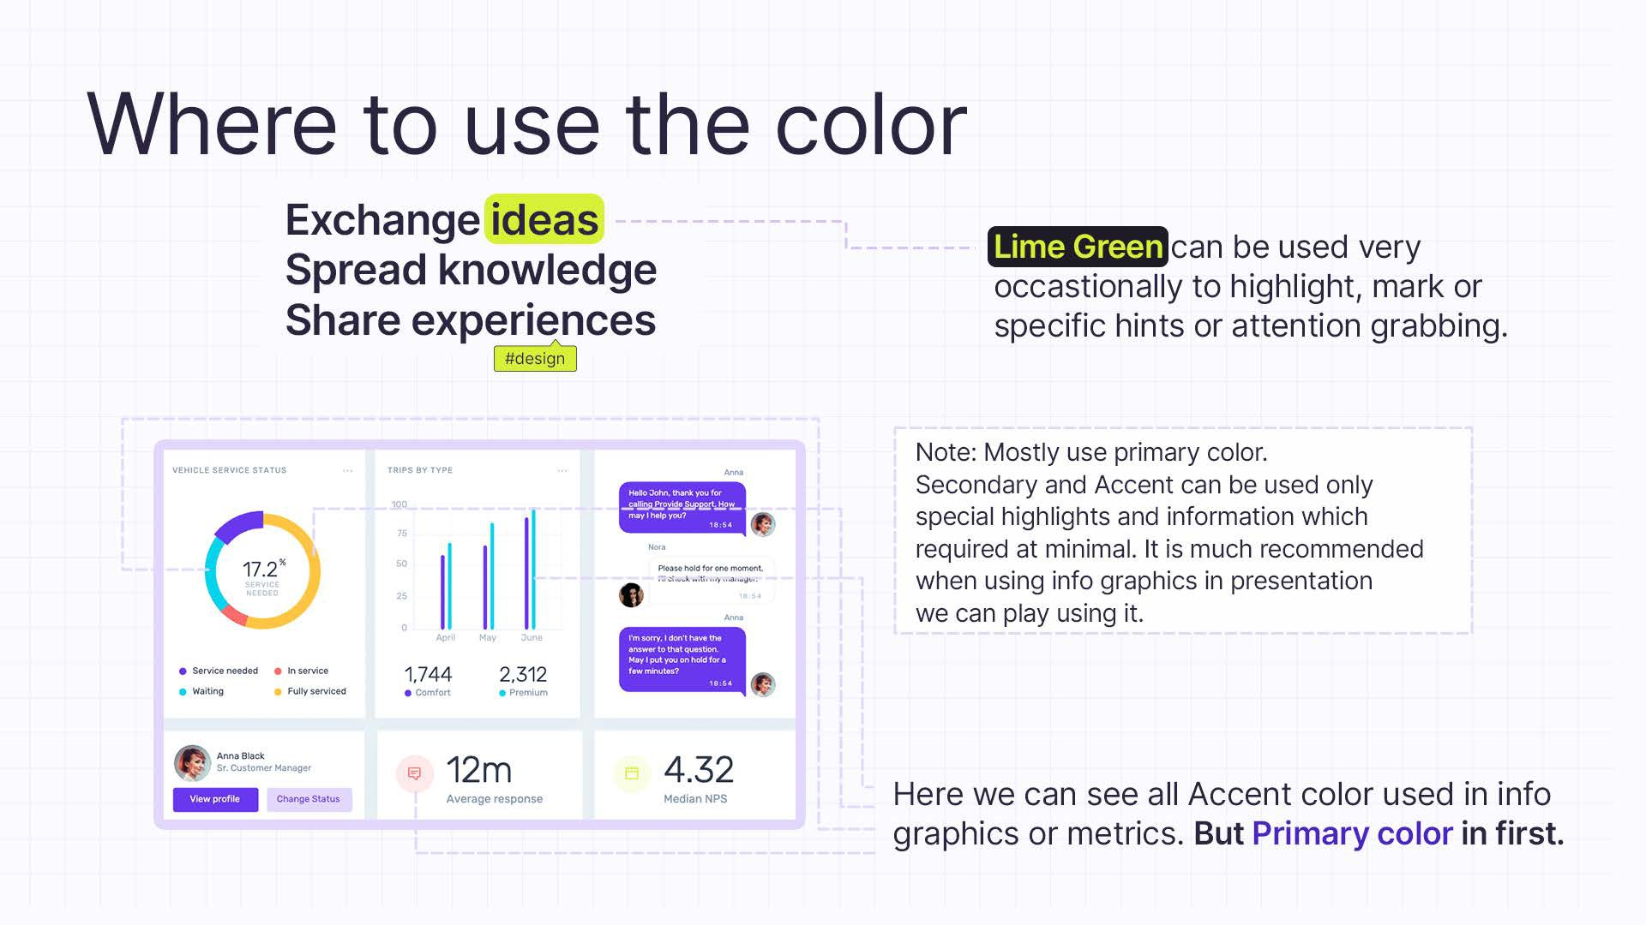

Slide 14
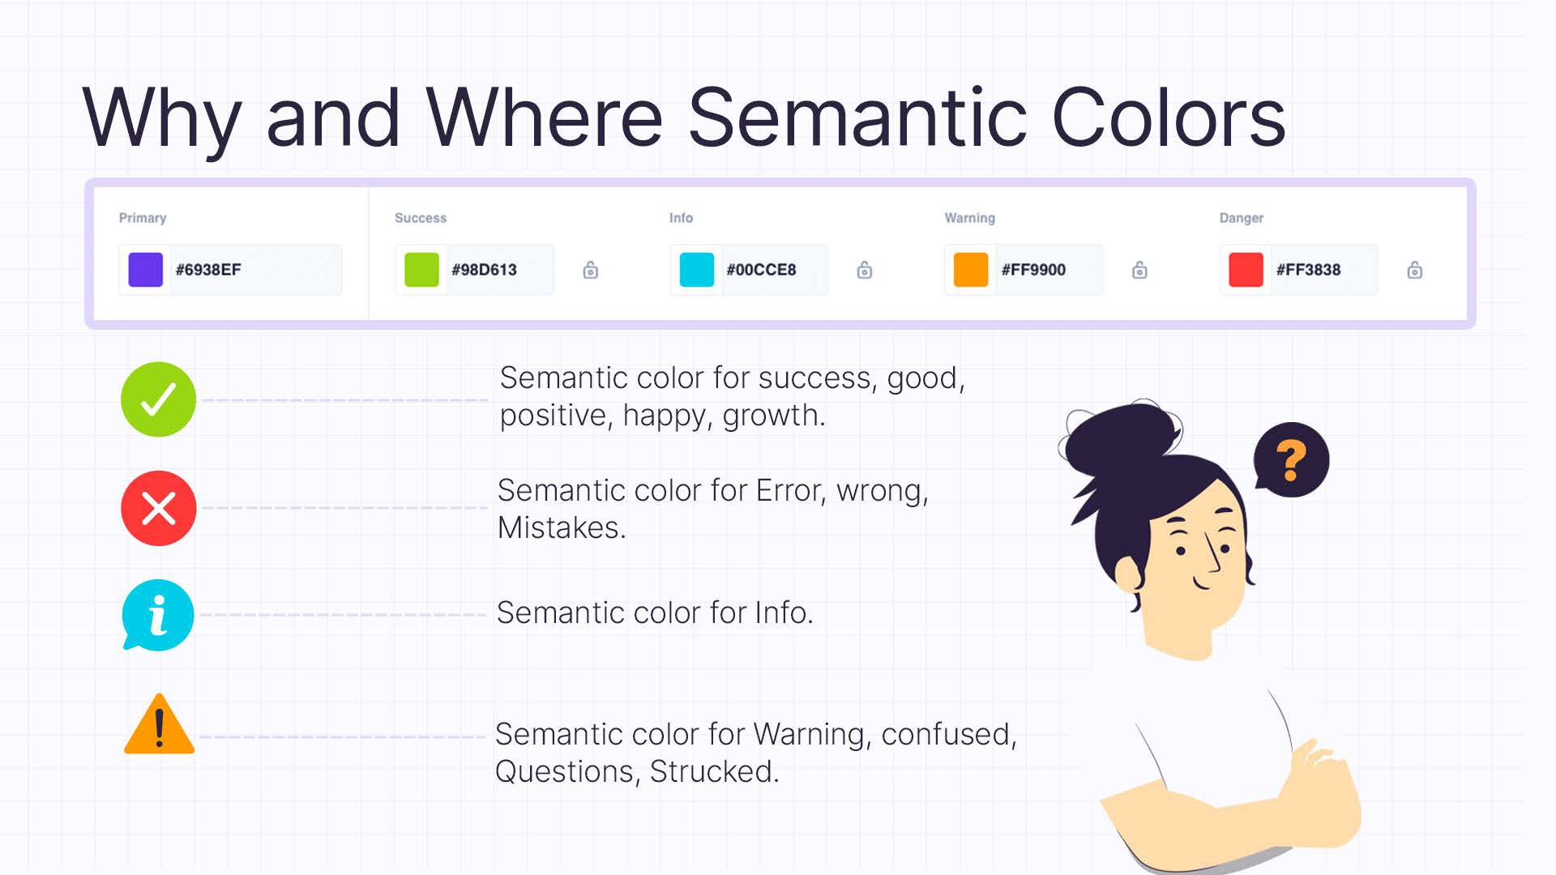

Slide 15
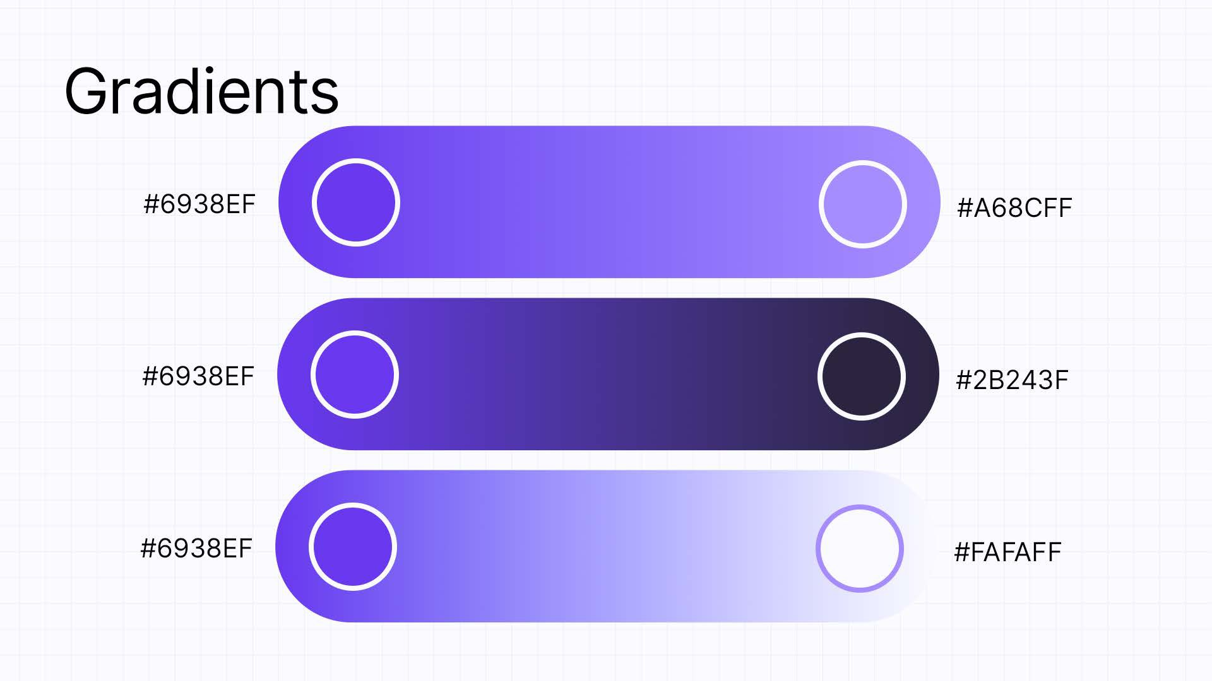

Slide 16
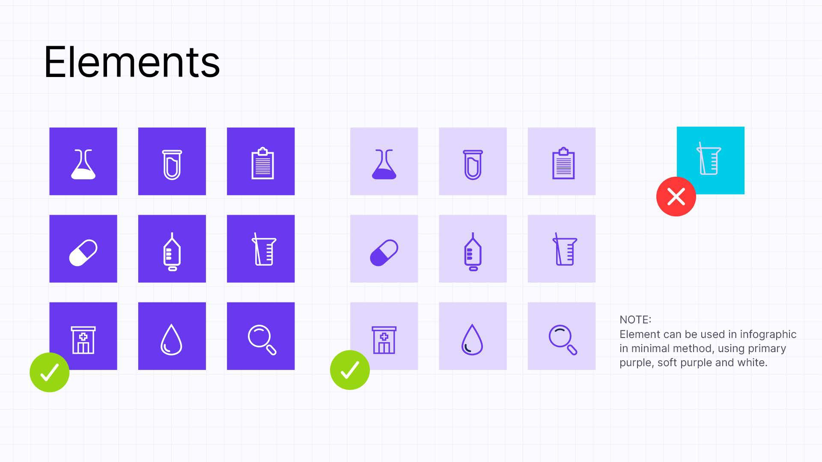

Slide 17


Slide 18


Slide 19


Slide 20



Download Here

Slide 21





Our Location
Chennai : Primus Building, Door No. SP–7A, Guindy Industrial Estate, SIDCO Industrial Estate, Guindy, Chennai, Tamil Nadu 600032
Bangalore : Lower Ground Floor, Diamond District, Tower B, HAL Old Airport Rd, Kodihalli, Bengaluru, Karnataka 560008
info@entropik.io
080 4375 9863
www.entropik.io

